Slide 1
Computerized Provider Order Entry (CPOE) Project Plan
HCA 660
Christina McClenaghan
Dwane McGowan
Matthew Mabalot

Slide 2
Agenda
Project Overview
Value Provided to Customers
Project Scope and Limitations
Deliverables for Pilot Project
Timeline
Tactical Plan Gantt Chart
Risk Matrix
Budget
Q & A

Slide 3
Vision Statement
To ensure that the Midwest Health Care Group continues to be a regional leader, excelling in the provision of safe, quality, cost effective, and timely care for our patients. We must also strive to provide a workplace for our staff and physicians that is the envy of all health care groups. Implementation of a key meaningful use (MU) core objective such as CPOE will allow the full potential of the existing electronic health record system to take effect, reducing costly errors, improving patient safety, decreasing mortality and morbidity rates, and avoiding duplication of tests. It will save our group financially by reducing administrative staff costs, improving billing practices, and increase the transaction processing rate. This project will be implemented in phases, with the first implementation occurring as a pilot at one of our primary care clinics..

Slide 4
Project Overview
Midwest Health Care Group will benefit from the implementation of a CPOE system in the following ways:
1) Improved clinical decision-making in conjunction with existing HER and DSS technology.
2) Reduction in medication errors and associated costs.
3) Improved patient safety.
4) Decreased length of stay in hospital.
5) Workflow process improvement.
6) Compliance with federal requirements for Stage II of meaningful use.
7) Improved physician clinical staff satisfaction over time.
8) Reduction/elimination of paper orders and legibility issues.

Slide 5
Project objectives
The project has the following major objectives:
1) Implementation of a pilot Clinical Provider Order Entry system at one of the systems primary care clinics that meets or exceeds MU requirements.
2) Creation of a unified implementation road map for eventual expansion of CPOE throughout all campuses of the Midwest Health Care Group.
3) Development of clinical order sets, alerts, and protocols.
4) Development of downtime procedures for planned/unplanned downtime.
5) Creation of key documentation for staff use during/following implementation.
6) Identification of resources required to maintain and expand CPOE at MHCG in the future.
7) Develop capabilities to capture data in order to produce required reports (public health reporting).

Slide 6
Value Provided to Customers
Conformance to physician outlines standard practice
Increased use of evidence-based medicine
Increased patient safety
Improved productivity
Reduction of duplicate services
Improved reporting on public health issues

Slide 7
Project Scope and Limitations
Scope of Initial Release
The initial implementation of CPOE will be limited to one facility, using a pilot project approach to identify issues before going system-wide. It will involve nursing, radiology, physicians, pharmacy, and administration as appropriate. Workplace realignment, workflow, and physical reconfiguration of work spaces should also be a consideration.

Slide 8
Project Scope continued
Interface Scope
The vendor should be guaranteeing that the system selected for implementation will be capable of interfacing with the existing EHR system, although the same vendor is being used so this shouldn’t be an issue.
Organizational Scope
The implementation is to be as a pilot project initially, to identify any areas of concern.

Slide 9
Project Scope continued
Organizational Scope
The implementation is to be as a pilot project initially, to identify any areas of concern.
Conversion Scope
The conversion process should involve:
1) Converting existing data to new system format, ensuring the data is complete, accurate, and current.
2) IS staff should take the lead, with input from end-users (clinical, administrative).
3) Use of a system of validation checkpoints for accuracy and reliability after conversion.
4) Testing with live data, involving IS, vendors, end-users, and administrative staff as appropriate.

Slide 10
Project Scope continued
Scope of Subsequent Releases
Subsequent implementation of this CPOE system is subject to executive approval and successful roll-out of this pilot project.
Out of Scope
Billing functions are not within the scope of this implementation.
Scheduling and registration are not in the scope of the scope of the current implementation.
Cleaning up backlog of maintenance request for order entry improvements and enhancements.
Physicians’ non-order documentation
Structured notes
Flowsheets

Slide 11
Deliverables
Team Charter
Project Definition Plan
Budget Plan
Weekly status report to client
PowerPoint presentation
Final Report

Slide 12
Team Roles
Project Role | Team Member
CFO/Project Coordinator: keep track of deliverables, schedule team meetings; keep all involved abreast of changes to scope/workflow/updates to project charter | Christina McClenaghan
CNO/Project Ambassador: provide clinical knowledge and support; solicit feedback from clinical staff; foster buy-in | Dwayne McGowan
CIO/Project Manager: provide technical knowledge to support implementation; facilitate creation of selection criteria for CPOE system to be used for pilot implementation and beyond | Matthew Mabalot

Slide 13
Timeline
Initiate planning on 03/11/13 and present project plan to the board on­ 03/28/13.
Upon Approval, the Pilot Project will commence on 07/30/13_________ and be completed by _12/01/13_____________.
Approximate date of completion of major phases: 07/30/13

Slide 14
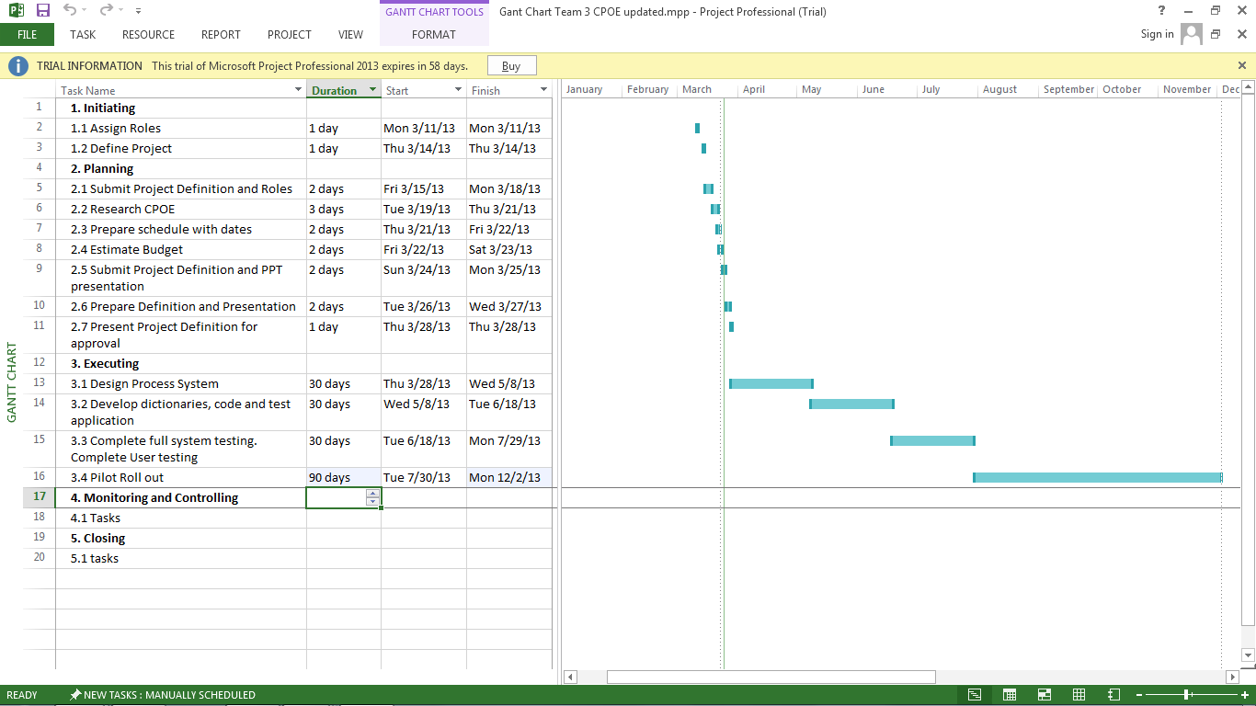
Tactical plan Gantt Chart

Slide 15
IT SUPPORT of organizational goals
Goal | IS Initiatives
Improve writing orders to physicians and pharmacists | Implement CPOE
Improve Care with CPOE and CDS | Monitor the types of detected drug interactions through the system
Improve safety for patients | Evaluate CPOE system by detecting the common prescribed errors and report on it
Reduce Costs and financial stability | Install revenue system and report on financial increases and reductions
Patient Care quality improvement | Create data repository for quality measurement in CPOE

Slide 16
Risk matrix
Risks | Mitigation
Provider Resistance | Need a physician champion on board for all phases of project
Data quality within the existing system may affect decision support system (DSS) effectiveness | Old data should be screened for clarity, completeness, accuracy, and validated
Aggressive implementation timeframe | Work with vendor and IS to establish a realistic timeframe
IS overly extended with competing projects | Coordinate timetable and resources with IS
Inadequate training of providers/staff, underestimation of training required | Develop a comprehensive, ongoing training plan, with vendor taking the lead
Scope creep-costly, with delays | Adhere to the established plan, unless changes are approved
Large number of prerequisite tasks required | Assign staff, monitor task completion closely

Slide 17
Budget
Capital Budget | $60 million
Order Set Development and Implementation (CPOE) | $1.2 million
One-Time Capital Costs | $200,000.00
One-Time Operating Costs | $70,000.00
Proposed Ongoing Costs (Pilot Only) | $120,000.00
Contingency | $60,000.00
Total Budget for Pilot CPOE Implementation | $1.65 million

Slide 18
Upcoming Milestones
Upon approval, The CPOE project organization team will begin executing the project by designing the process system and developing the CPOE application.
Once the design is complete and the team is satisfied with result, the team will conduct full system testing and complete user testing. The team will then monitor and control the application including training throughout the implementation.

Slide 19
Q & A

